Slide 1
Computer Graphics
Lecture -02

Slide 2
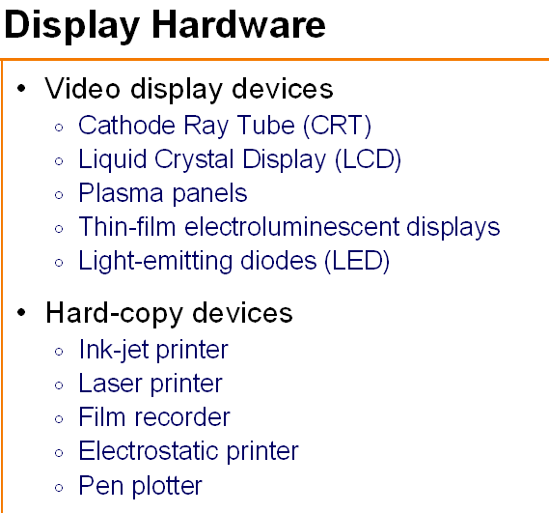

Slide 3
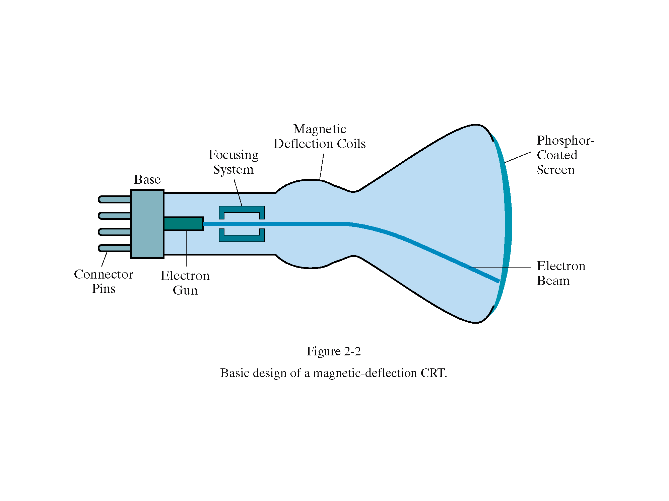

Slide 4
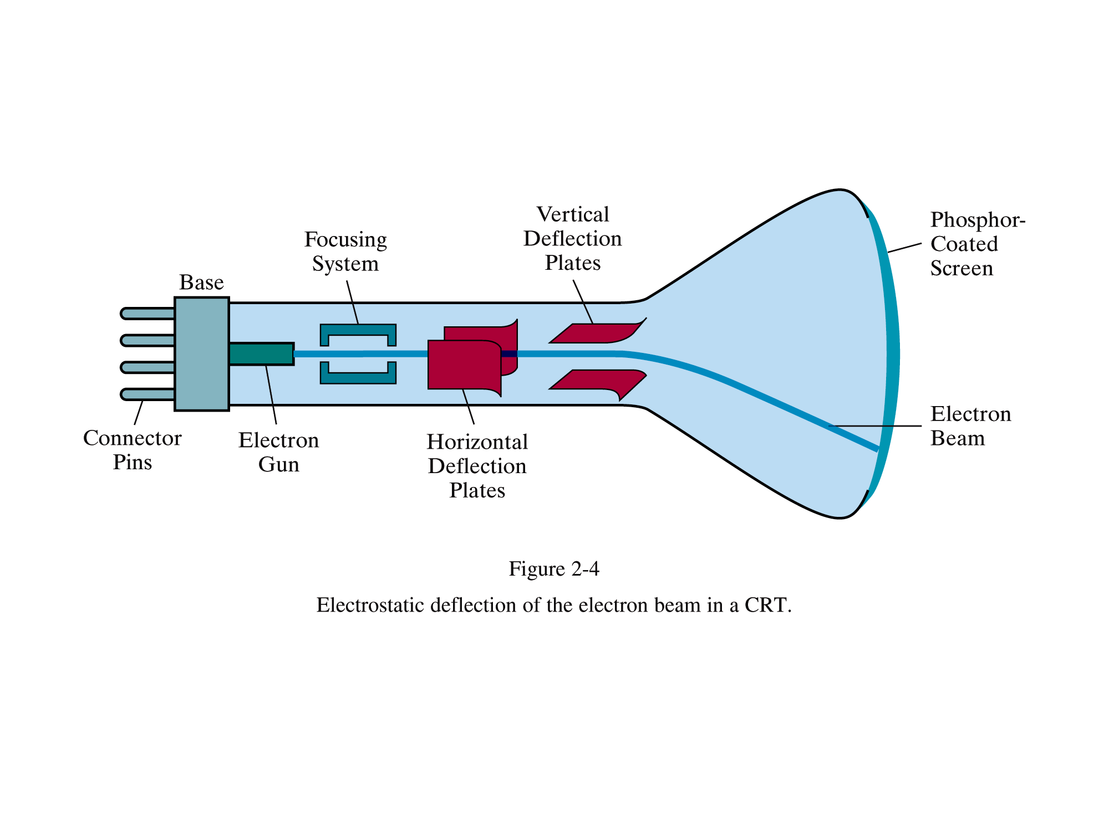

Slide 5
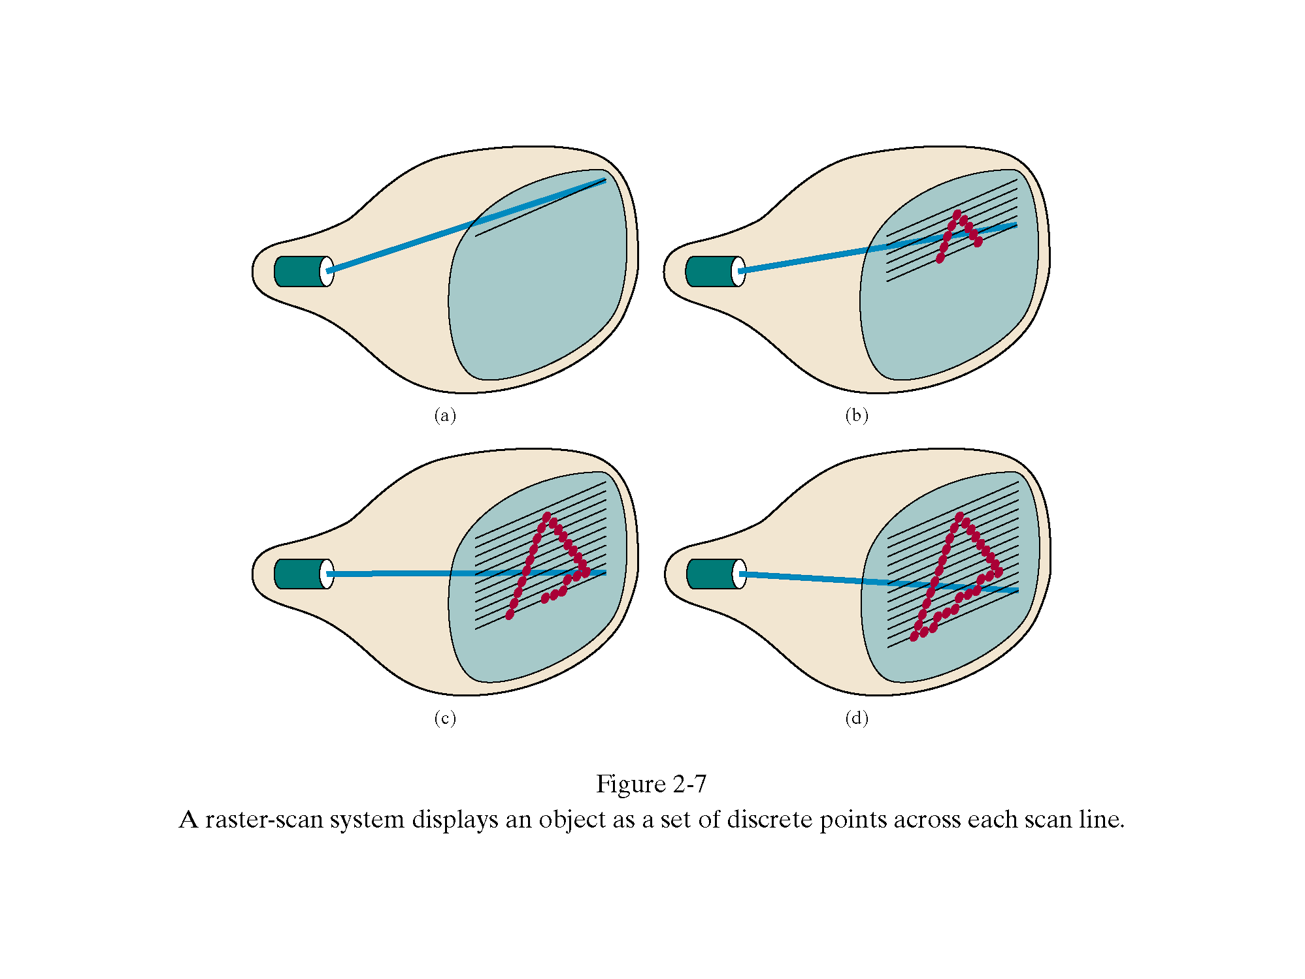

Slide 6
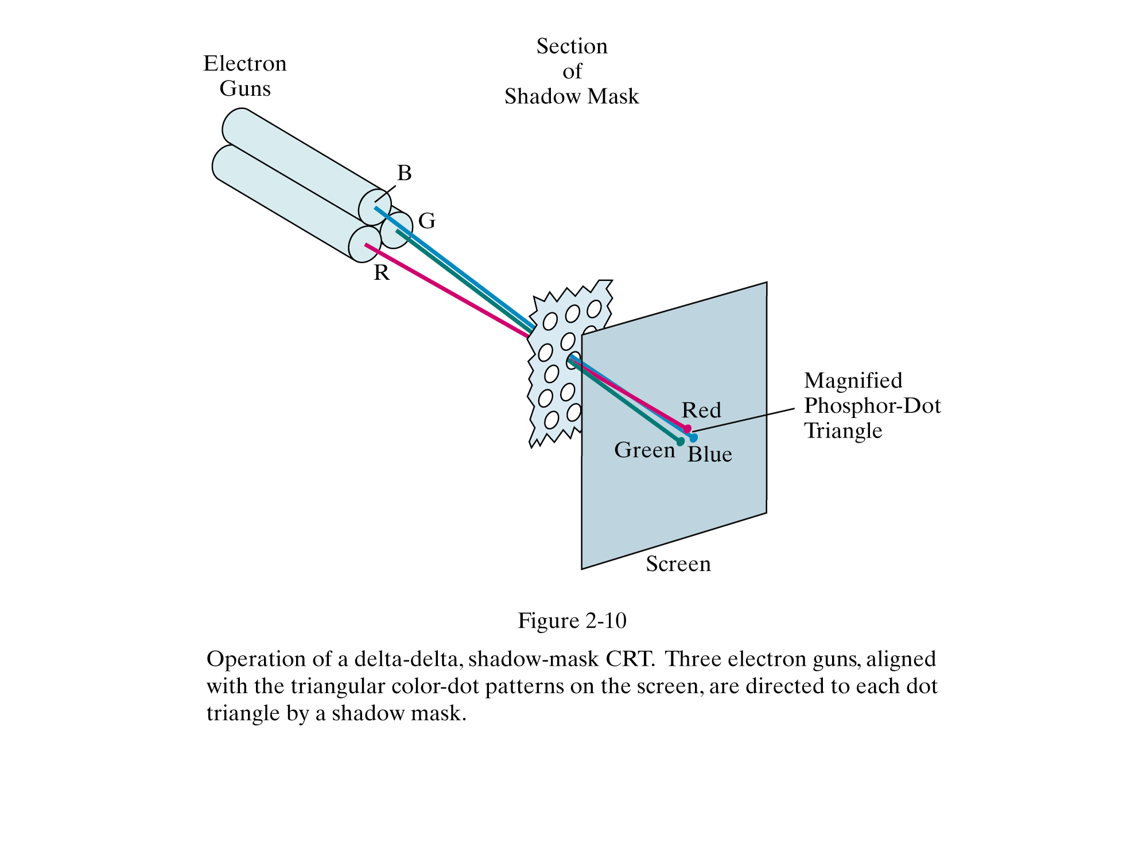

Slide 7

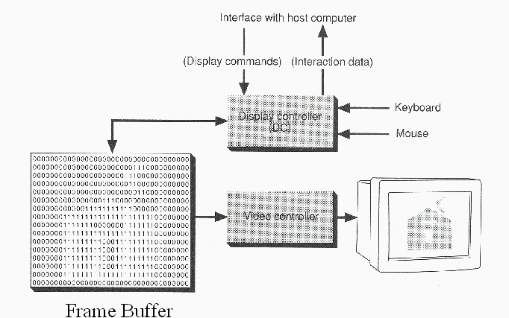

Slide 8

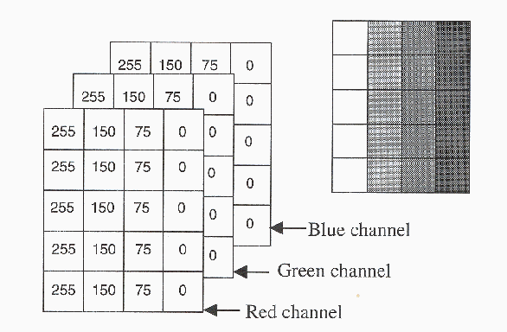

Slide 9

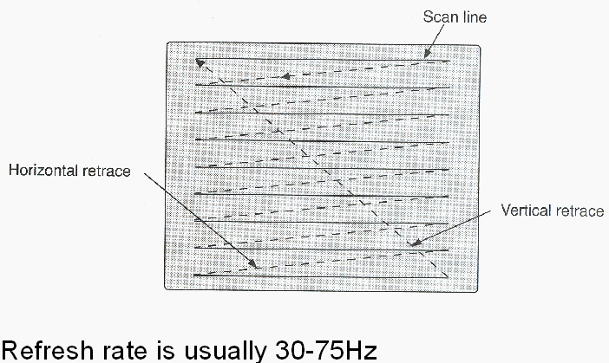

Slide 10
Frame Buffer
The image being displayed is stored in a dedicated system memory area that is often referred to as Frame Buffer or Refresh Buffer.
The frequency at which content of frame buffer is sent to display monitor is called Refreshing rate ( 60 Hz)

Slide 11
Resolution of Image
Resolution is number of pixels per unit length ( eg. Inch) in the horizontal and vertical direction.
Ex: A 3x2 inch image at a resolution of 300 pixels per inch will have a total of 540,000 pixels.

Slide 12
Image Size
Image Size is given as total number of pixels in horizontal times the total number in vertical direction
Eg. In the above case it is 900 x 600 is the Image Size.

Slide 13
Aspect Ratio
The ratio of images’s width to its height , measured in unit length or number of pixels is called aspect ratio
Eg. 2x2 inch image and 512x512 image will have aspect ratio of 1
Or 6 x 41/2 inch image and 1024x768 have an aspect ratio of 4/3

Slide 14
Colors – Direct coding
3 bits for each pixel with one bit for each primary color.
A widely used standard is 24 bits or 3 bytes with one byte for each primary color to have 256 different intensity levels corresponding to binary values from 00000000 to 11111111
Thus a pixel can take a color from 256x256x256 or 16.7 million possible choices

Slide 15
Problems-Try this
In a raster display, if we use, RGB values with 2 bits per primary color, how many possible colors do we have for each pixel????
Ans : 64 ….how ?

Slide 16
Try this
If a system(256x256 pixel display) has 5 bit planes in its frame buffer and the LUT is 8 bits wide:
Find the memory requirements for
i) Frame buffer
ii) LUT

Slide 17
Thumb Rule
If a raster display system has color depth of b bits (so that there are b bitplanes in its frame buffer) and that each LUT entry is w bits wide, then the system can display 2^{w} colors any 2^{b} at one time
LUT memory = 2^{b} words of w bits each
Frame buffer memory = resolution of display * bpp of frame buffer

Slide 18
Sol
LUT memory = 2⁵ x 8 = 32x8= 256 bits = 32 bytes
Frame buffer memory = resolution of display * bpp of frame buffer = 256x256x 5 = 40,960 bytes

Slide 19
Try this
There are 2 systems for a display of 1024x1280
i. 24 bpp frame buffer and no LUT
ii 8 bpp frame buffer with 24bits wide LUT
Which is better ??? And why ???

Slide 20
Sol:
i. 4.853 MB for frame buffer
ii 1 MB for frame buffer with LUT = 768 BYTES of memory
ii is better than i as it is less expensive

Slide 21
Try this
If we use 2 byte pixel values in a 24-bit LUT , how many bytes the LUT occupy ?

Slide 22
Sol
2¹⁶ x 24 / 8 = 196,608

Slide 23
Try this
If we want to cut a 512x512 sub-image out from the center of an 800x600 image, what are the co-ordinates of the pixel in the large image that is at the lower left corner of the small image ?

Slide 24
Sol
[(800-512)/2, (600-512)/2] = (144,44)

Slide 25
Display Technologies
Cathode Ray Tubes (CRTs)
  Most common display device today
  Evacuated glass bottle
  Extremely high voltage
  Heating element (filament)
  Electrons pulled towards
  anode focusing cylinder
  Vertical and horizontal deflection plates
  Beam strikes phosphor coating on front of tube

Slide 26
Electron Gun
Contains a filament that, when heated, emits a stream of electrons
Electrons are focused with an electromagnet into a sharp beam and directed to a specific point of the face of the picture tube
The front surface of the picture tube is coated with small phospher dots
When the beam hits a phospher dot it glows with a brightness proportional to the strength of the beam and how often it is excited by the beam

Slide 27
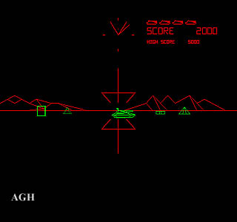
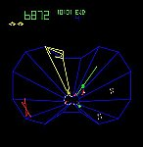
Display Technologies: CRTs
Vector Displays
  Anybody remember Battlezone? Tempest?

Slide 28
Display Technologies: CRTs
Vector Displays
  Early computer displays: basically an oscilloscope
  Control X,Y with vertical/horizontal plate voltage
  Often used intensity as Z
Name two disadvantages
Just does wireframe
Complex scenes  visible flicker

Slide 29
Display Technologies: CRTs
Raster Displays
  Raster: A rectangular array of points or dots
  Pixel: One dot or picture element of the raster
  Scan line: A row of pixels

Slide 30
Display Technologies: CRTs
Raster Displays
  Black and white television: an oscilloscope with a fixed scan pattern: left to right, top to bottom
  To paint the screen, computer needs to synchronize with the scanning pattern of raster
    Solution: special memory to buffer image with scan-out synchronous to the raster. We call this the framebuffer.

Slide 31
Display Technologies: CRTs
Phosphors
  Fluorescence: Light emitted while the phosphor is being struck by electrons
  Phosphorescence: Light emitted once the electron beam is removed
  Persistence: The time from the removal of the excitation to the moment when phosphorescence has decayed to 10% of the initial light output OR duration of phosphorescence.

Slide 32
Display Technologies: CRTs
Raster Displays
  Frame must be “refreshed” to draw new images
  As new pixels are struck by electron beam, others are decaying
  Electron beam must hit all pixels frequently to eliminate flicker
  Critical fusion frequency
    Typically 60 times/sec
    Varies with intensity, individuals, phospher persistence, lighting...

Slide 33
Display Technologies: CRTs
Raster Displays
  Interlaced Scanning
  Assume can only scan 30 times / second
  To reduce flicker, divide frame into two “fields” of odd and even lines
1/30 Sec
1/30 Sec
1/60 Sec
1/60 Sec
1/60 Sec
1/60 Sec
Field 1
Field 2
Field 1
Field 2
Frame
Frame

Slide 34
Display Technologies: CRTs
Raster Displays
  Scanning (left to right, top to bottom)
    Vertical Sync Pulse: Signals the start of the next field
    Vertical Retrace: Time needed to get from the bottom of the current field to the top of the next field
    Horizontal Sync Pulse: Signals the start of the new scan line
    Horizontal Retrace: The time needed to get from the end of the current scan line to the start of the next scan line

Slide 35
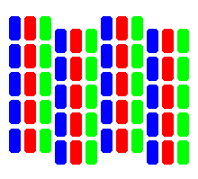
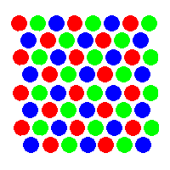
Display Technology: Color CRTs
Color CRTs are much more complicated
  Requires manufacturing very precise geometry
  Uses a pattern of color phosphors on the screen:
Delta electron gun arrangement
In-line electron gun arrangement
Why red, green, and blue phosphors?

Slide 36
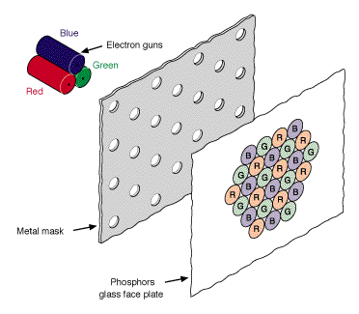
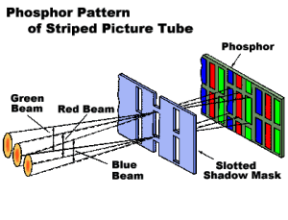
Display Technology: Color CRTs
Color CRTs have
  Three electron guns
  A metal shadow mask to differentiate the beams

Slide 37
Display Technology: Raster
Raster CRT pros:
  Allows solids, not just wireframes
  Leverages low-cost CRT technology (i.e., TVs)
  Bright! Display emits light
Cons:
  Requires screen-size memory array
  Discreet sampling (pixels)
  Practical limit on size (call it 40 inches)
  Bulky
  Finicky (convergence, warp, etc)

Slide 38
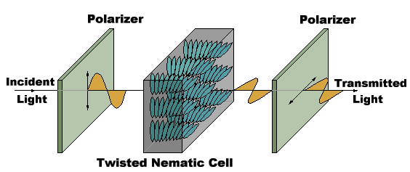
Display Technology: LCDs
Liquid Crystal Displays (LCDs)
  LCDs: organic molecules, naturally in crystalline state, that liquefy when excited by heat or E field
  Crystalline state twists polarized light 90º.

Slide 39
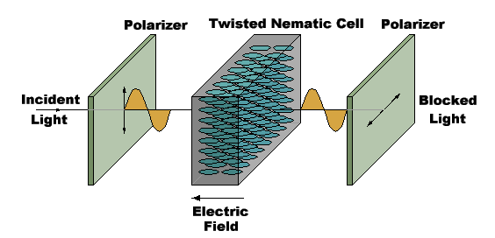
Display Technology: LCDs
Liquid Crystal Displays (LCDs)
  LCDs: organic molecules, naturally in crystalline state, that liquefy when excited by heat or E field
  Crystalline state twists polarized light 90º

Slide 40
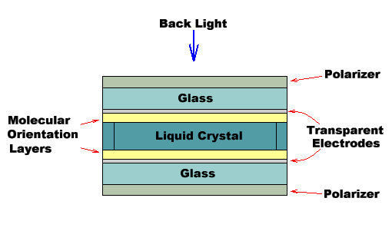
LCDs
Transmissive & reflective LCDs:
  LCDs act as light valves, not light emitters, and thus rely on an external light source.
  Laptop screen: backlit, transmissive display
  Palm Pilot/Game Boy: reflective display

Slide 41
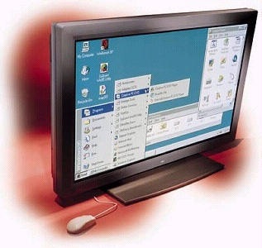
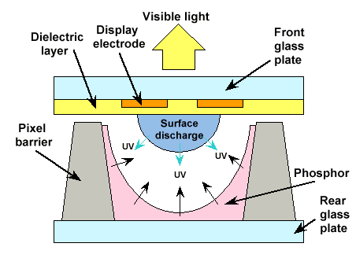
Plasma Panels
Plasma display panels
  Similar in principle to
  fluorescent light tubes
  Small gas-filled capsules
  are excited by electric field,
  emits UV light
  UV excites phosphor
  Phosphor relaxes, emits
  some other color

Slide 42
Display Technology
Plasma Display Panel Pros
  Large viewing angle
  Good for large-format displays
  Fairly bright
Cons
  Expensive
  Large pixels (~1 mm versus ~0.2 mm)
  Phosphors gradually deplete
  Less bright than CRTs, using more power

